Slide 1

Survival Analysis – Part 2
Nina Gunnes
February 4, 2021

Slide 2
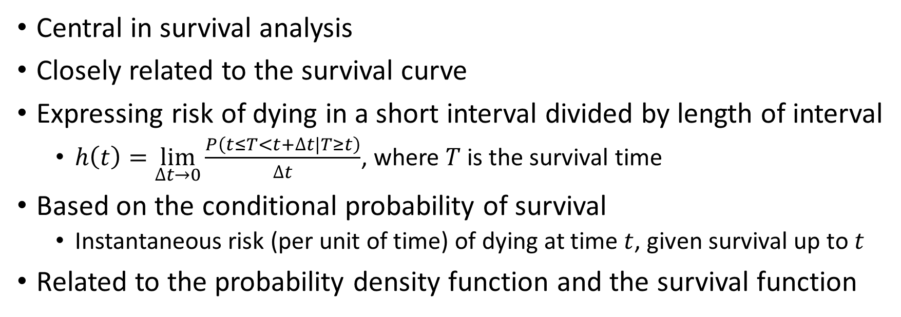
Hazard function
Central in survival analysis
Closely related to the survival curve
Expressing risk of dying in a short interval divided by length of interval
  $h\left(t\right)=\lim_{∆t→0}{\frac{P\left(t≤T<t+∆t|T≥t\right)}{∆t}}$, where $T$ is the survival time
Based on the conditional probability of survival
  Instantaneous risk (per unit of time) of dying at time $t$, given survival up to $t$
Related to the probability density function and the survival function

Slide 3
Cox regression
Named after the British statistician Sir David Cox
  Cox (1972)
Also know as proportional-hazards regression
Estimating the effect of potential risk factors on survival time
One of the most widely used (and misused) methods in biostatistics
  Many traps to fall into
No assumption about the distribution of survival times

Slide 4
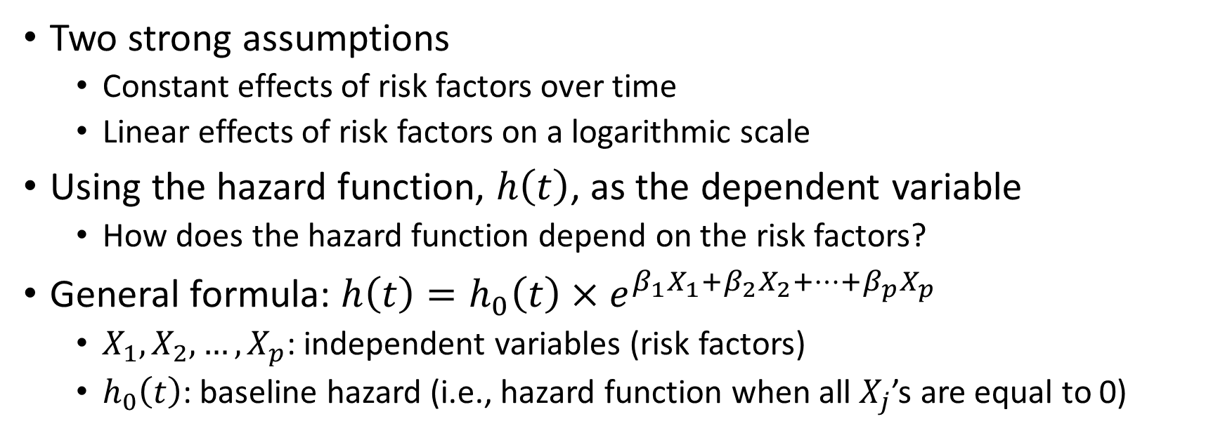
Cox regression, cont.
Two strong assumptions
  Constant effects of risk factors over time
  Linear effects of risk factors on a logarithmic scale
Using the hazard function, $h\left(t\right)$, as the dependent variable
  How does the hazard function depend on the risk factors?
General formula: $h\left(t\right)=h_{0}\left(t\right)×e^{β_{1}X_{1}+β_{2}X_{2}+…+β_{p}X_{p}}$
  $X_{1},X_{2},…,X_{p}$: independent variables (risk factors)
  $h_{0}\left(t\right)$: baseline hazard (i.e., hazard function when all $X_{j}$’s are equal to 0)

Slide 5
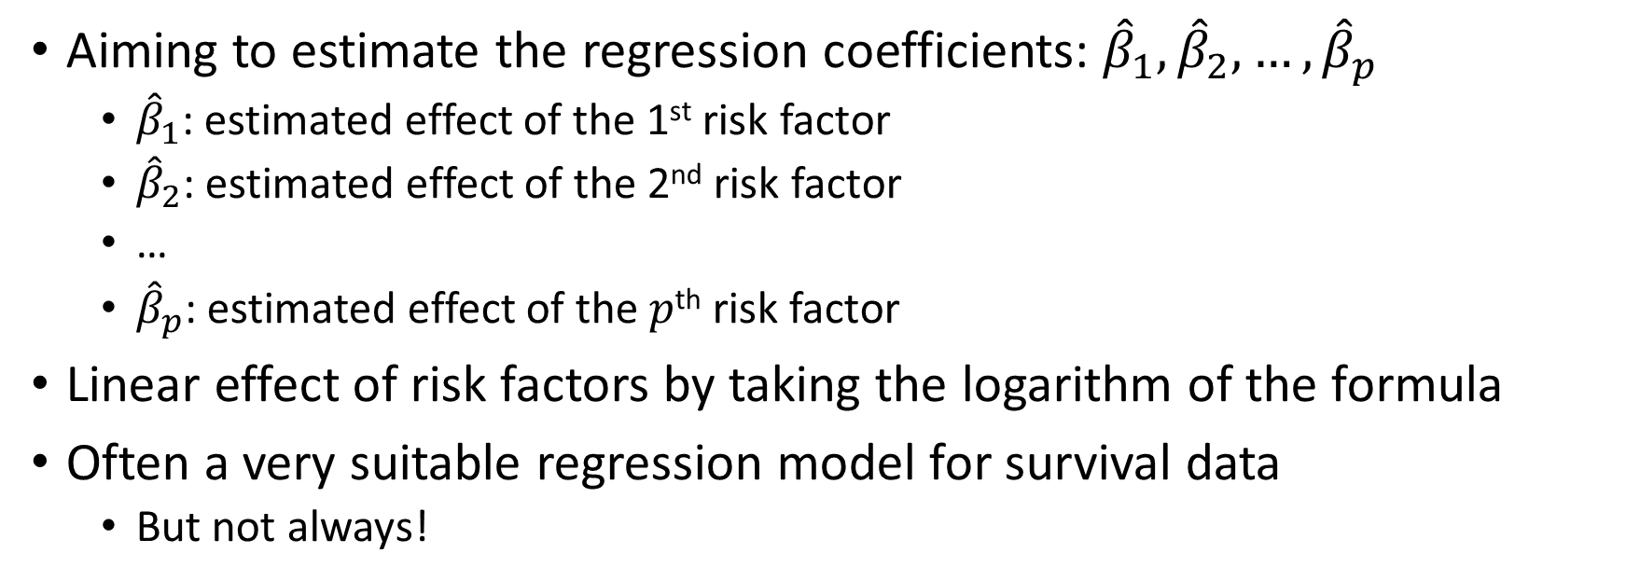
Cox regression, cont.
Aiming to estimate the regression coefficients: ${\hat{β}}_{1},{\hat{β}}_{2},…,{\hat{β}}_{p}$
  ${\hat{β}}_{1}$: estimated effect of the 1st risk factor
  ${\hat{β}}_{2}$: estimated effect of the 2nd risk factor
  …
  ${\hat{β}}_{p}$: estimated effect of the $p$^{th} risk factor
Linear effect of risk factors by taking the logarithm of the formula
Often a very suitable regression model for survival data
  But not always!

Slide 6
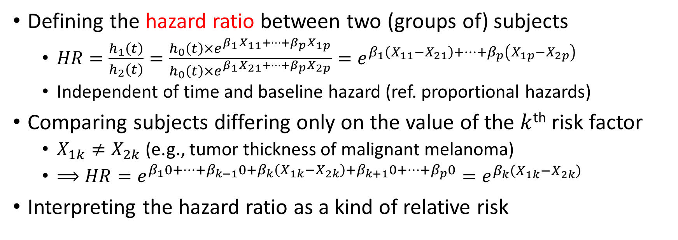
Cox regression, cont.
Defining the hazard ratio between two (groups of) subjects
  $HR=\frac{h_{1}\left(t\right)}{h_{2}\left(t\right)}=\frac{h_{0}\left(t\right)×e^{β_{1}X_{11}+…+β_{p}X_{1p}}}{h_{0}\left(t\right)×e^{β_{1}X_{21}+…+β_{p}X_{2p}}}=e^{β_{1}\left(X_{11}−X_{21}\right)+…+β_{p}\left(X_{1p}−X_{2p}\right)}$
  Independent of time and baseline hazard (ref. proportional hazards)
Comparing subjects differing only on the value of the $k$^{th} risk factor
  $X_{1k}≠X_{2k}$ (e.g., tumor thickness of malignant melanoma)
  $⟹HR=e^{β_{1}0+…+β_{k−1}0+β_{k}\left(X_{1k}−X_{2k}\right)+β_{k+1}0+…+β_{p}0}=e^{β_{k}\left(X_{1k}−X_{2k}\right)}$
Interpreting the hazard ratio as a kind of relative risk

Slide 7
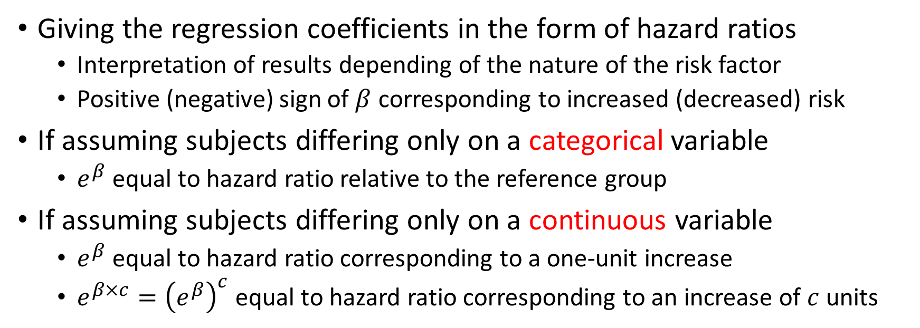
Cox regression, cont.
Giving the regression coefficients in the form of hazard ratios
  Interpretation of results depending of the nature of the risk factor
  Positive (negative) sign of $β$ corresponding to increased (decreased) risk
If assuming subjects differing only on a categorical variable
  $e^{β}$ equal to hazard ratio relative to the reference group
If assuming subjects differing only on a continuous variable
  $e^{β}$ equal to hazard ratio corresponding to a one-unit increase
  $e^{β×c}={\left(e^{β}\right)}^{c}$ equal to hazard ratio corresponding to an increase of $c$ units

Slide 8
Example: Primary biliary cirrhosis
Considering data from a study on primary biliary cirrhosis (PBC)
312 patients diagnosed with cirrhosis
  Referral to Mayo Clinic between January 1974 and May 1984
Patients randomized to one of two groups
  DPCA (D-penicillamine)
  Placebo
Patients followed until death or censoring
  End of study in July 1986

Slide 9
Example: Primary biliary cirrhosis, cont.
125 of 312 patients dead by the end of follow-up
  65 patients in the DPCA group
  60 patients in the placebo group
Study described in Chapter 3 of the book by Laake et al. (2007)
PBC data and variable description available for download at https://www.med.uio.no/imb/personer/vit/veierod/boker/epidemiologiske-og-kliniske-forskningsmetoder/datafiler/.

Slide 10
Example: Primary biliary cirrhosis, cont.
312 observations
6 variables
  case: ID number
  time: time of follow-up (in days)
  censor: status at the end of follow-up (0 – censored, 1 – dead)
  treatmen: treatment (0 – placebo, 1 – DPCA)
  age: age (in years)
  bilirubi: serum bilirubin (in mg/dl)

Slide 11
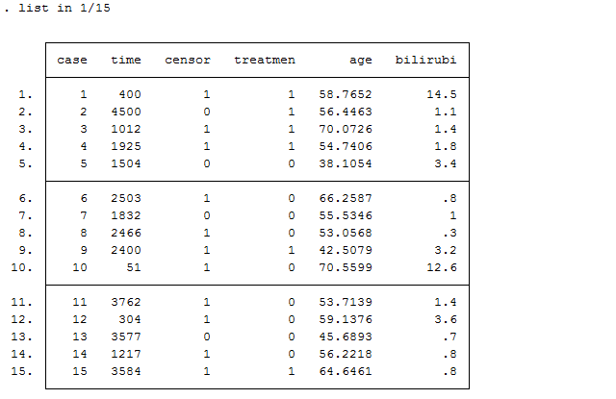
Example: Primary biliary cirrhosis, cont.
Listing values of variables
  15 first observations

Slide 12
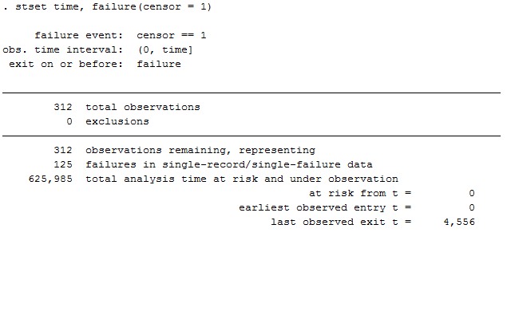
Example: Primary biliary cirrhosis, cont.
Declaring survival-time data
  Time of follow-up given by time
  Failure event given by censor

Slide 13
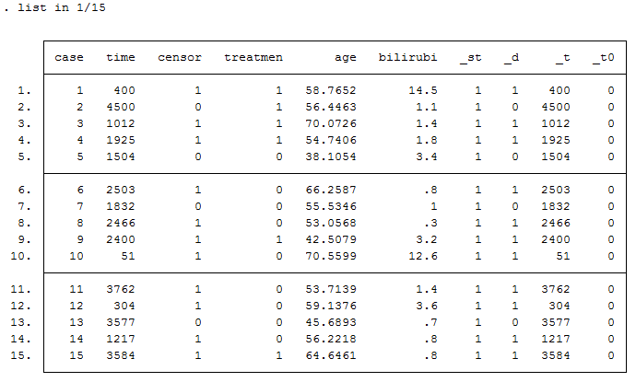
Example: Primary biliary cirrhosis, cont.
New variables generated
  _st: indicator for inclusion
  _d: indicator for event of interest
  _t: survival time
  _t0: time of entry into analysis

Slide 14
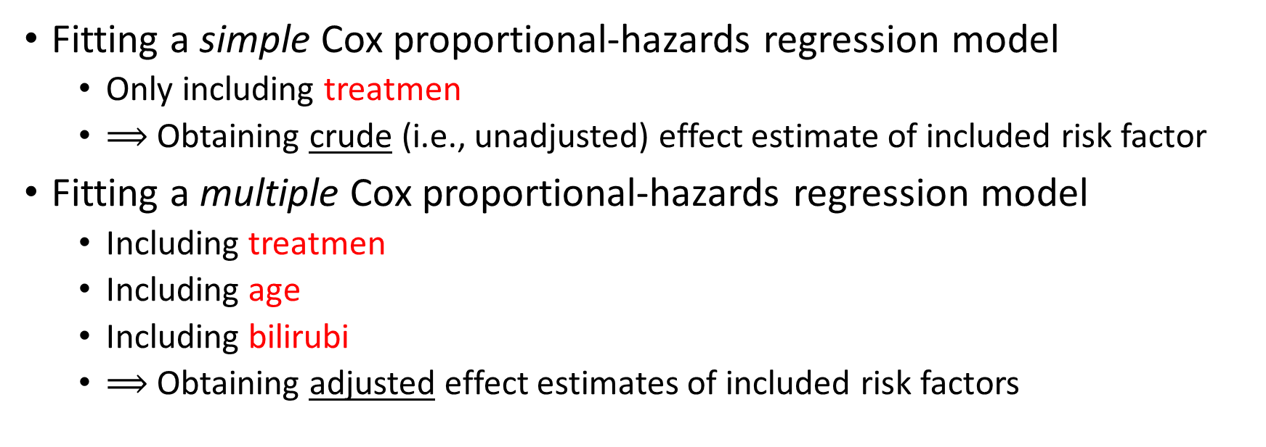
Example: Primary biliary cirrhosis, cont.
Fitting a simple Cox proportional-hazards regression model
  Only including treatmen
  $⟹$ Obtaining crude (i.e., unadjusted) effect estimate of included risk factor
Fitting a multiple Cox proportional-hazards regression model
  Including treatmen
  Including age
  Including bilirubi
  $⟹$ Obtaining adjusted effect estimates of included risk factors

Slide 15
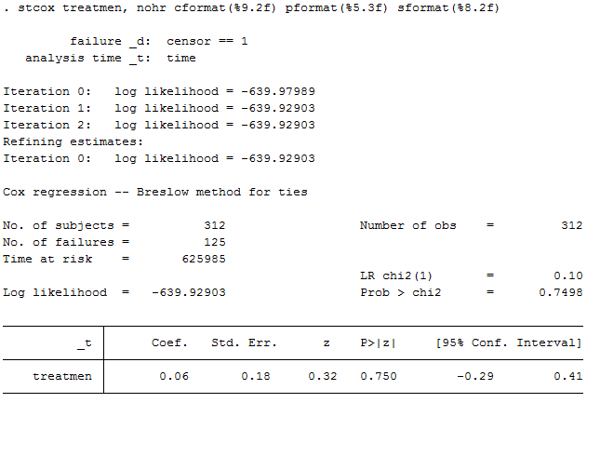
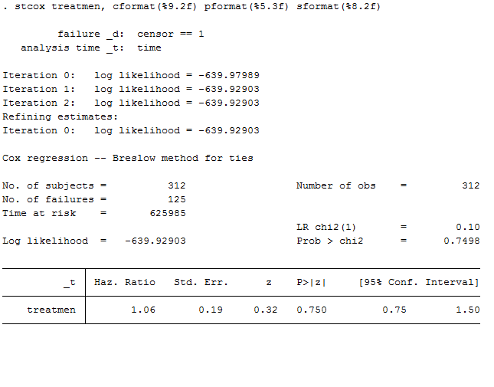
Example: Primary biliary cirrhosis, cont.

Slide 16
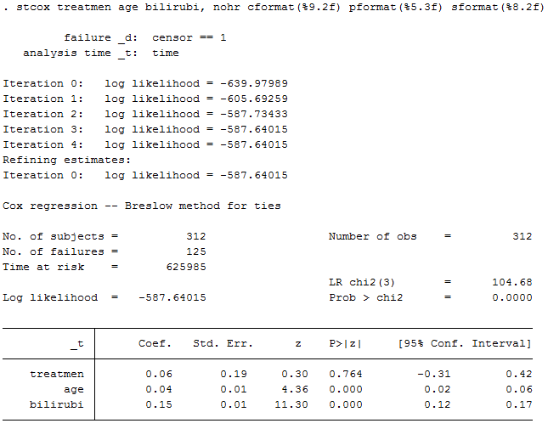
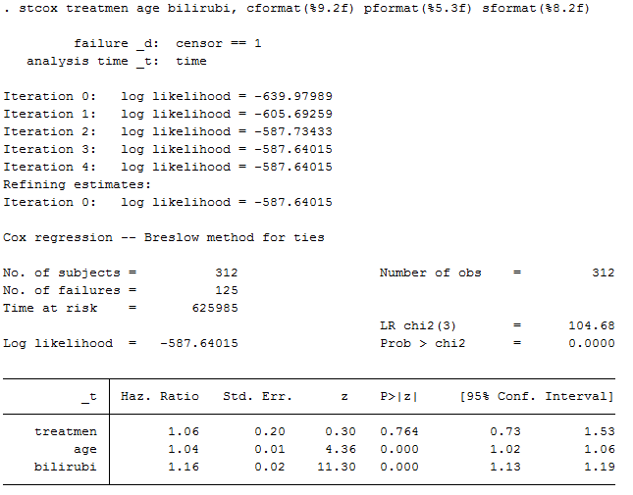
Example: Primary biliary cirrhosis, cont.

Slide 17
Example: Primary biliary cirrhosis, cont.
Similar results for treatment effect in crude and adjusted analyses
  Balanced treatment groups due to randomization
Risk increased by 6% for patients in DPCA group
  Adjusted for age and serum bilirubin
Risk increased by 4% for each one-year increase of age
  Adjusted for treatment and serum bilirubin
Risk increased by 16% for each increase of 1 mg/dl of serum bilirubin
  Adjusted for treatment and age

Slide 18
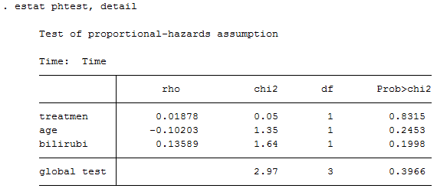

Example: Primary biliary cirrhosis, cont.
Testing PH assumption
  Based on Schoenfeld residuals
Statistically significant result
  $⟹$ PH assumption violated

Slide 19
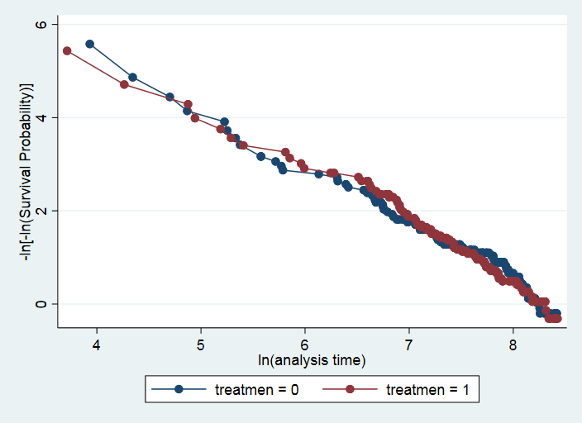
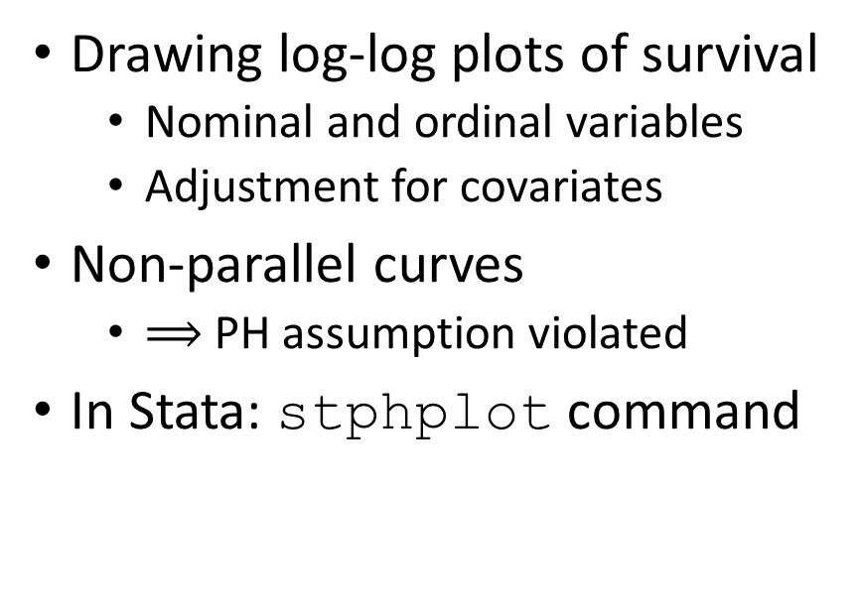
Example: Primary biliary cirrhosis, cont.
Drawing log-log plots of survival
  Nominal and ordinal variables
  Adjustment for covariates
Non-parallel curves
  $⟹$ PH assumption violated
In Stata: stphplot command

Slide 20
References
Aalen OO, Frigessi A, Moger TA, Scheel I, Skovlund E, Veierød MB. Statistiske metoder i medisin og helsefag. Oslo: Gyldendal akademisk; 2006.
Cox DR. Regression Models and Life-Tables. J R Stat Soc Series B Stat Methodol. 1972;34(2):187–220. https://doi.org/10.1111/j.2517-6161.1972.tb00899.x.
Laake P, Hjartåker A, Thelle DS, Veierød MB. Epidemiologiske og kliniske forskningsmetoder. Oslo: Gyldendal akademisk; 2007. https://www.med.uio.no/imb/forskning/publikasjoner/boker/2007/epidemiolgiske-kliniske-forskningsmetoder.html.

